Slide 1



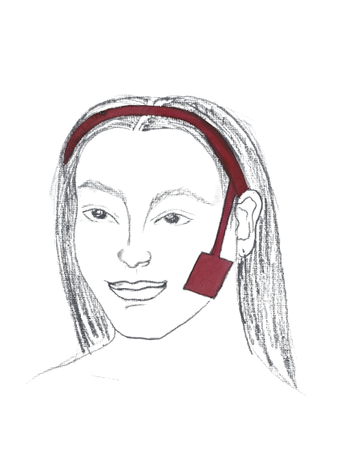

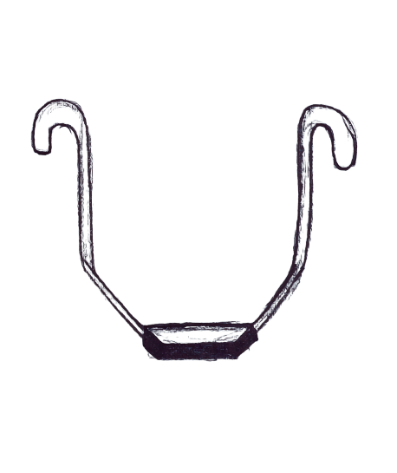
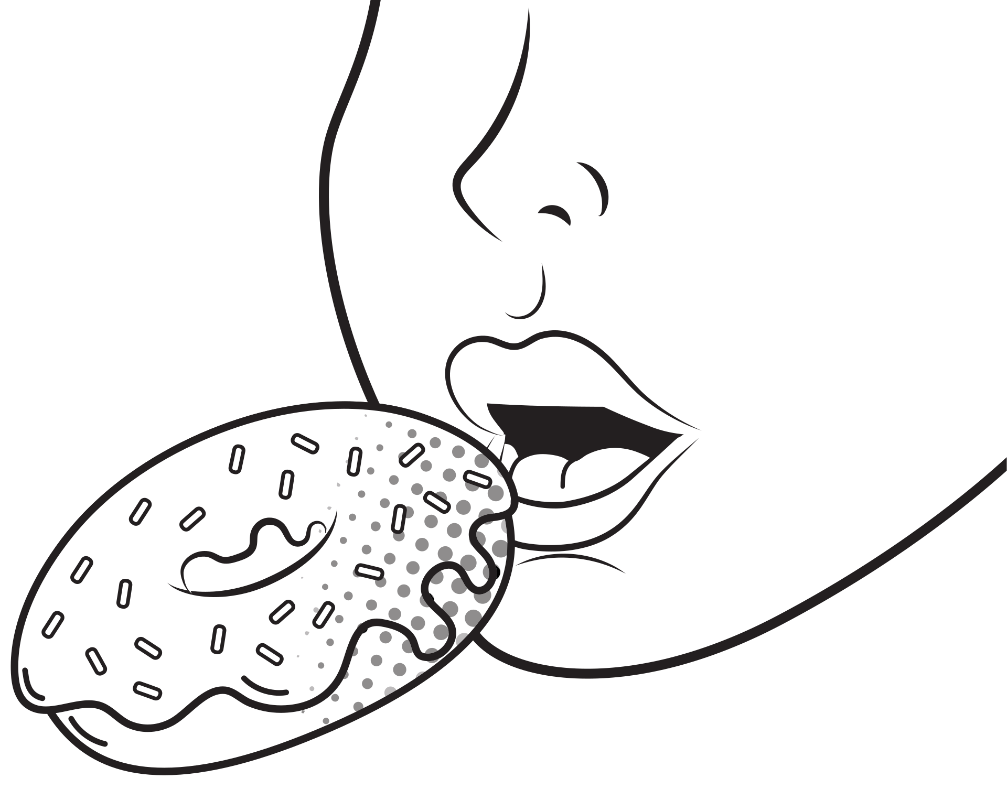

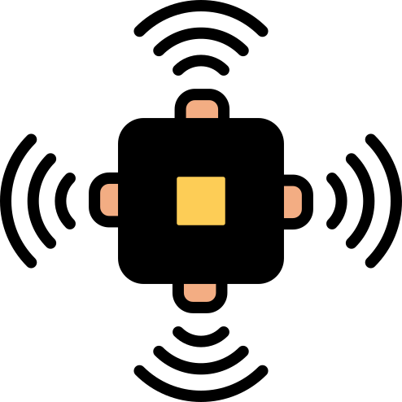


Habit Counter

Slide 2
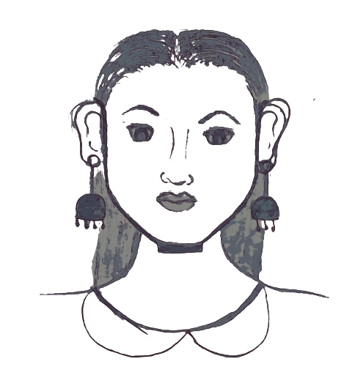
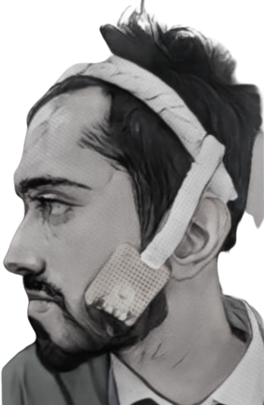
How to use

Slide 3

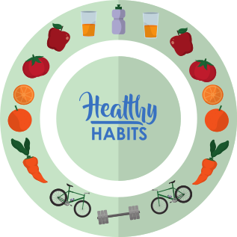

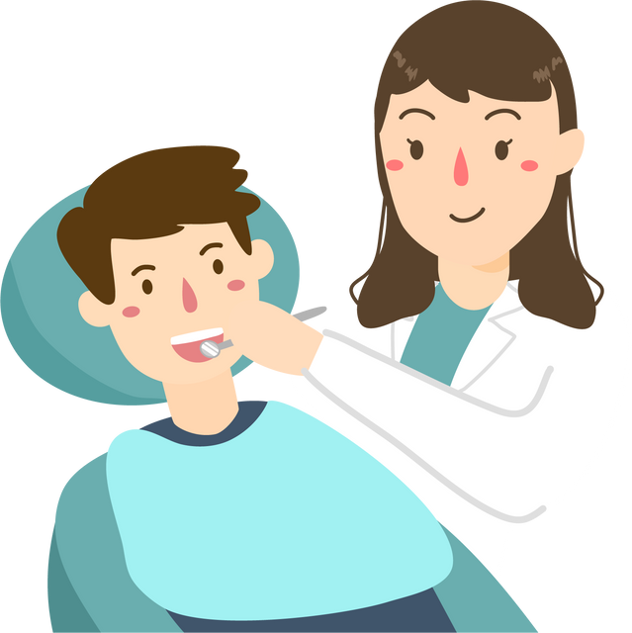
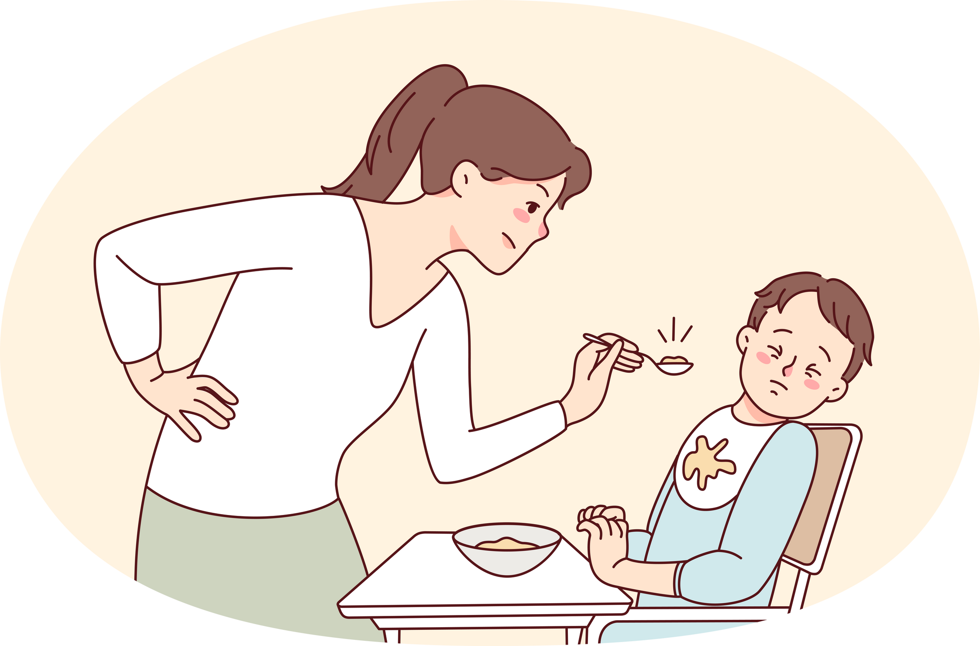

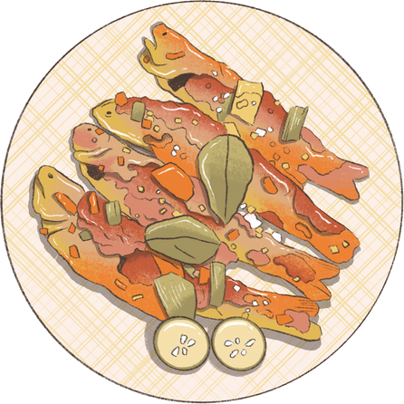
TEAM
FIVE
MONITORING YOUR
DIET ROUTINE
Parental Monitoring
Patient with
a dental issue or food disorder
Chewing sensor

Slide 4


USES OF THIS DEVICE
Oral Health Monitoring
Dietary Analysis
Bruxism Detection
Healhy Eating Management:
Research and Clinical Use:

